Slide 1
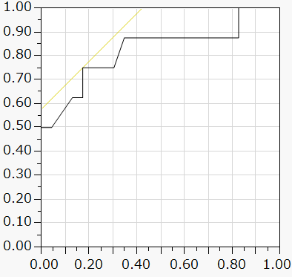
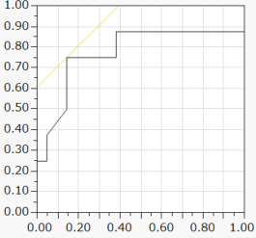
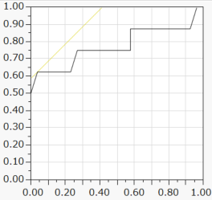
A
B
sensitivity
sensitivity
1-specificity
1-specificity
C
sensitivity
1-specificity
Figure E1

